Slide 1

Camden Supportive Housing
Bill Maroon, MSW
Business and Organizational Development Specialist

Slide 2

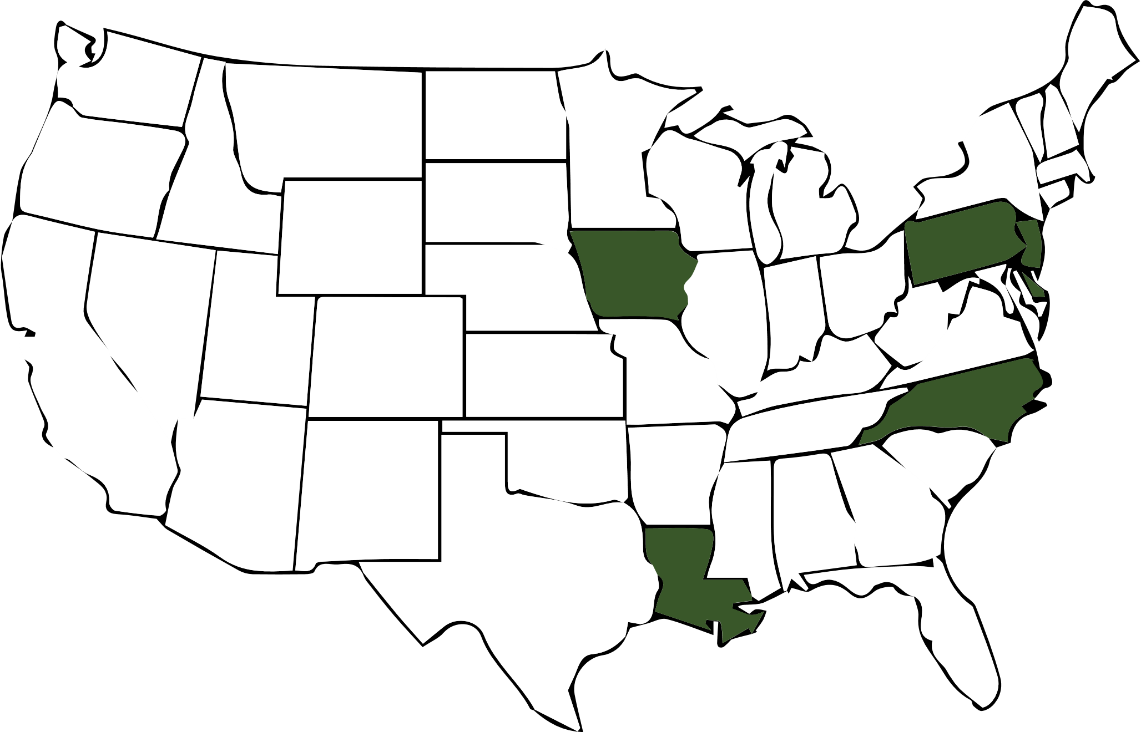
RHD supports 2000+ people living in Supportive Housing programs in 6 States
6/14
STATES

Slide 3


2008
The Camden Supportive Housing Program started as part of a needle exchange continuum compiled by the New Jersey Department of Human Services Division of Addiction Services
VERY CONTROVERSIAL
(at the time)
31
Housing
Vouchers

Slide 4

First 31 individuals were
HOMELESS or AT HIGH RISK OF HOMELESSNESS
& either connected to
Camden Methadone Program or Needle Exchange
PARTNERSHIP & REFERRAL PROCESS
MAT
Methadone
Assisted
Treatment
NEEDLE
EXCHANGE
HOUSING
PROGRAMS

Slide 5
MISSION
Housing First initiative utilizes the Intensive Supportive Housing team to provide comprehensive, recovery-oriented case management services to individuals who are homeless or at risk of homelessness
Strives to embody the Values of RHD while embracing the tenets of Harm Reduction and Housing First.

Slide 6
TODAY (10 years later)…
0
DEATHS DUE TO OVERDOSE!

Slide 7

HOUSING RETENTION (87%)
55
Tenants since 2008

Slide 8

HOUSING RETENTION (87%)
24/55
LEFT
PROGRAM

Slide 9


HOUSING RETENTION (87%)
14/24
SUCCESSFUL
DISCHARGES
Graduated to independent living
without voucher
Moved in with family
Moved to another state
Moved to a medical facility

Slide 10
HOUSING RETENTION (87%)
6/24
EVICTIONS
with discharge from services

Slide 11
HOUSING RETENTION (87%)
3/24
DEATHS
due to medical reasons

Slide 12
HOUSING RETENTION (87%)
1/24
long-term
INCARCERATION

Slide 13
RECOVERY (90% of current residents)
90%
remain clean of illegal substances
Economic reality as a barrier to recovery
90%
of current tenants are fully engaged in MAT
3
current residents titrated off MAT and working full time

Slide 14
EMPLOYMENT
2014
47% (15/31)
MRE
Many with MRE graduated from the program
Some did not maintain MRE Supported Employment
TODAY
23% (7/31)
long-term MRE
47%
Supported Employment or MRE
MRE = Market Rate Employment

Slide 15



TODAY (10 years later)…
71 People?
31 Vouchers

Slide 16
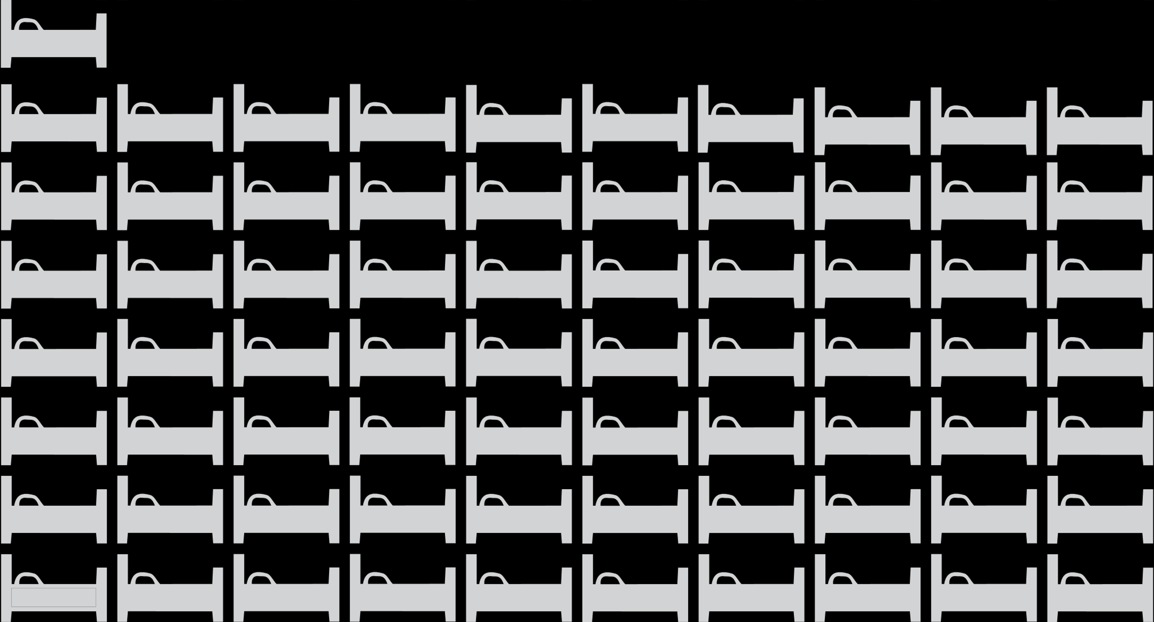



FAMILY (31 vouchers – 71 people)
26
Children under 18
6
Children over 18
(pay rent or in school)
39
Adults

Slide 17

FAMILY REUNIFICATION (89%)
18 cases
CPS involvement

Slide 18


FAMILY REUNIFICATION (89%)
10 cases
opened at child birth
ALL TENANTS KEPT CUSTODY OF CHILDREN

Slide 19

FAMILY REUNIFICATION (89%)
7 cases
Opened prior to coming into program
WE REUNITED 5 FAMILIES

Slide 20


FAMILY REUNIFICATION (89%)
1 case
opened during services
FAMILY STAYED UNIFIED

Slide 21

FAMILY REUNIFICATION (89%)
16 cases of
REUNIFICATION
OR
UNIFICATION
which represents
22 CHILDREN
WHO ARE NOT IN
FOSTER CARE TODAY!

Slide 22
Foster Care System only vs.
Camden Supportive Housing Program
22 children
(1 year)
71 people (includes 22 children)
(1 year)
$1,600,000
$2.2 million
$1.1 million -
$730-$750,000
$180 - $200,000 (housing)
$550,000 (services)
FOSTER CARE
CAMDEN SUPPORTIVE HOUSING
Notes:
3 kids in foster care = $200,000 - $225,000

Slide 23
Bill Maroon, MSW
Business and Organizational Development Specialist
bmaroon@rhd.org
www.rhd.org

