Slide 1
THE TRAUMA RECOVERY EMPOWERMENT MODEL
AND WORKING WITH VETERANS
Tom Wagner, MA

Slide 2
Agenda
Intro
What Is Trauma?
Trauma Recovery Empowerment Model
Veteran Culture
Questions

Slide 4
DEFINITION
Direct personal experience of an event that involves an actual or perceived threat of death or injury
A sudden shock to the system

Slide 5
TYPES
Physical violence
Psychological maltreatment
Witnessing violence
Neglect
Sudden loss
Manmade and natural disasters

Slide 6
TRAUMA
Trauma, MH issues, D&A use and homelessness are tied in a recurring cycle
Exposure to violence and abuse is often not identified as significant
Violence not seen as impacting other life problems
Under reported and under recognized

Slide 7
Trauma Informed Approach
Safety: Ensuring physical and emotional safety
Trustworthiness: Maximizing trustworthiness, making tasks clear, and maintaining appropriate boundaries
Choice: Prioritizing consumer choice and control
Collaboration: Maximizing collaboration and sharing of power with consumers
Empowerment: Prioritizing consumer empowerment and skill-building

Slide 8
TREM
Developed by Community Connections in Washington, DC
First designed to work with female abuse survivors
Modified to work with a variety of populations

Slide 9
ASSUMPTIONS
Many individuals find it difficult to label and describe emotions
Disconnection dilemma
All or nothing responses
Trauma severs connections with one’s family, one’s community and one’s self

Slide 10
ASSUMPTIONS CONT.
People who experience repeated trauma in childhood often lack proper coping skills
Trauma survivors bring an array of skills and strengths to the recovery process
Dysfunctional behaviors may be legitimate coping responses to trauma
Trauma has physical, emotional, cognitive, behavioral and spiritual outcomes

Slide 11
MTREM
Male Messages, Emotions and Relationships
Gaining an Understanding of Trauma
Recovery Skills

Slide 12
PART 1
Introduction
Male Messages
Trust
Friendship
Anger and Behavior
Anger and Thinking

Slide 13
PART 1
Fear
Hurt and Loss
Hope
Shame
Sex
Intimacy

Slide 14
PART 2
Gaining an Understanding of Trauma
What Is Emotional Abuse?
What Is Physical Abuse
What Is Sexual Abuse
Abuse and Psychological/Emotional Sx
Trauma and Addictive or Compulsive Behs
Abuse and Relationships

Slide 15
PART 3
Revenge, Acceptance and Forgiveness
Negotiating Family Relationships
Communication Skills
Positive Problem Solving: Overcoming Self-Defeating Behaviors
Managing Feeling Out of Control
Realistic Goals and Empowerment

Slide 16
STRUCTURE
Check In
Session Rationale
Goals
Questions
Exercises
1 hour 15 Minutes

Slide 17
CONCEPT
Not designed to deeply explore one’s trauma story
Emphasis on making connections between abuse and current functioning and assisting in recovery skill building
One’s report of trauma is drawn into the group context

Slide 18
VET-TREM
Modified version of original TREM
Worked with Community Connections to develop the model
Integrates various aspects of Military Culture
Peer to peer approach

Slide 19
“I, …., Do Solemnly Swear That I Will Protect and Defend …”

Slide 20
INDOCTRINATION

Slide 21
Basic Tenets of Military Culture
Duty, Honor, Country
Discipline
Professional Ethos
Ceremony and Etiquette
Cohesion

Slide 22
Cultural Comparison Civilian vs. Military
Civilian
Uniqueness
Individuality
Choices
Relaxation
Military
Uniformity
Anonymity
Orders
Boredom

Slide 23
Cultural Comparison Civilian vs. Military (cont.)
Civilian
Luxury
Disorder
Emotionality
Togetherness
Military
Hard Work
Chain of Command
Stoicism
Team Work

Slide 24
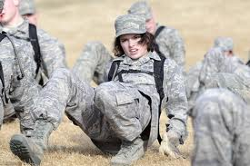
The Average Workday Is When The Mission Is Complete
Notes:
The average workday is when the mission is done

Slide 25
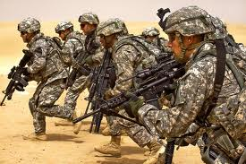
The Very Skills That Are Taught To Follow In Combat Are The Skills That Are A Risk At Home

Slide 26
Military Members Share Common Life Experiences That The General Population Does Not

Slide 27
“SUCK IT UP AND DRIVE ON!!!”

Slide 28
65% - Fear of being perceived as weak 63% - Fear that leadership will treat them differently 59% - fear others will have less confidence in them
Barriers To Seeking Treatment

Slide 29
12% of U.S. Population Are Veterans

Slide 30
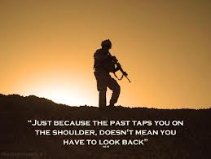
30% Of Treatment At The V.A. Is For PTSD Estimated 20% Of The Veteran Population Suffers From PTSD

Slide 31
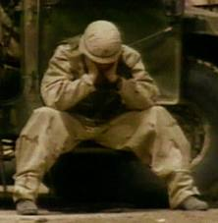
Suicide Rates
22 Veterans Commit Suicide Every Day
That’s 1 Every 65 Minutes
In 2012 There Were 349 Active Duty Suicides

Slide 32
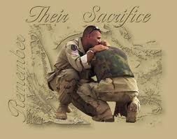
Leave No One Behind

Slide 33
Program Overview
Began in 2009
Goal was to aid in the reintegration of Iraq and Afghanistan War veterans’ transition back into civilian life.
Based on a Peer to Peer Approach:
Veterans helping Veterans
Utilizes a trauma-recovery psycho-educational group support model with modifications for combat veterans.

Slide 34
What are people saying?
“I Feel Like I Have a Future, Again”
- An Iraq veteran talking about his struggle, and how Healing Ajax has helped him.
“As a Veteran, Healing Ajax has helped me with needs that were hidden from me, needs that were masked or cloaked. These needs were met among a group of soldiers who were traumatized just like me. We became trauma educated, learning an approach to trauma, empowerment and trauma recovery.”

Slide 35
Things To Keep In Mind
Be culturally competent
Never Say “You’re Lucky”
Know or have access to someone that understands military culture
Before you ask be sure you are prepared to listen
Don’t speak the jargon unless you know it
Be ready for trust factor to take time

